Slide 1




Kubernetes Meets OpenTofu: A Recipe for IaC Success
Speaker: Nicola Marco Decandia
Sao Paulo – 24/02/2024

Slide 2



Nicola Marco Decandia
CNCF Ambassador
CEO Desotech
vExpert 2024

Slide 3
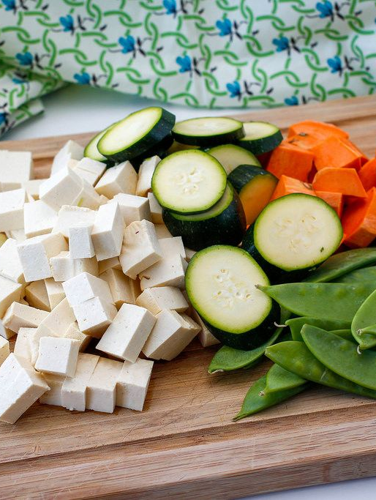

Ingredients for "Cooking OpenTofu"
Fresh OpenTofu from the Linux Foundation.
Generous code + pinch of open-source collaboration.
Cook with innovation until golden and automated.
Garnish with Kubernetes, Helm and community feedback.
Serve to hungry developers and system engineers.
This Photo by Unknown Author is licensed under CC BY

Slide 4
















Timeline
Slow initial
adoption
AWS CloudFormation
Terraform 0.1
Significant Growth
Released under the Mozilla Public License (v2.0) (the “MPL”)
Only support for AWS and Digital Ocean
Discussions on possibly shutting down the project
Over 750 contributors, more providers
Terraform
Fork
Terraform
Enterprise
License Changed
OpenTofu GA
Release of impactful Terraform 0.12
from MPL to the Business Source License (v1.1) (the “BUSL”)
OpenTofu maintained by The Linux Foundation

Slide 5
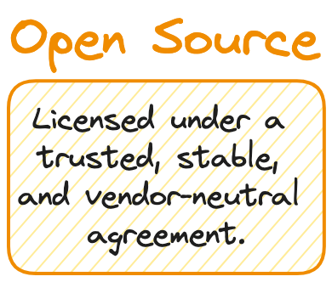

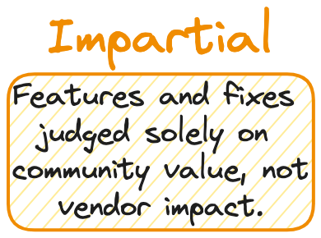



Slide 6

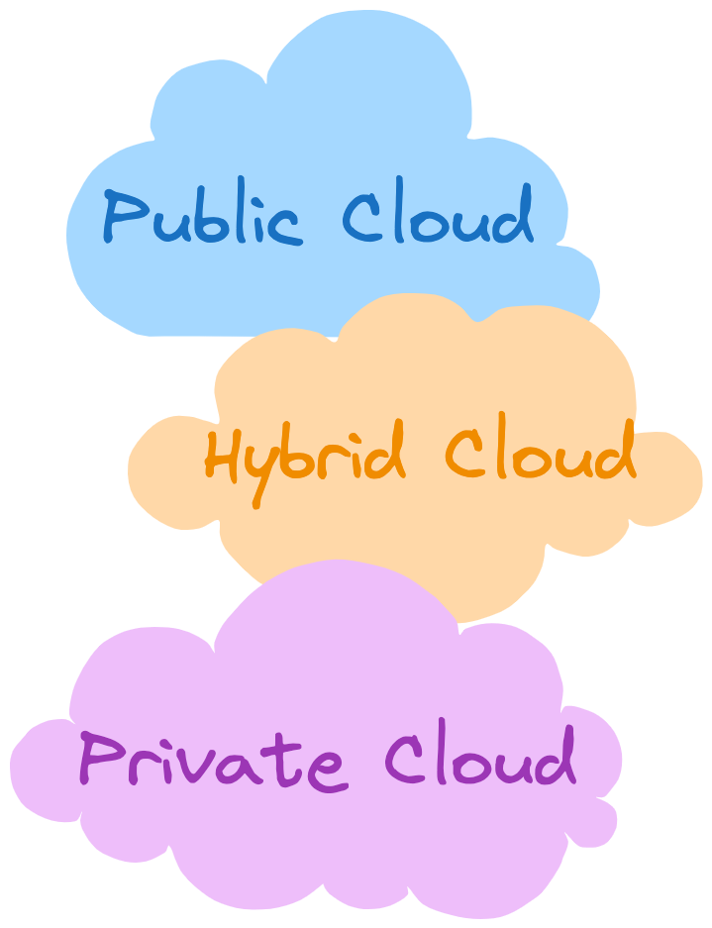












Slide 7
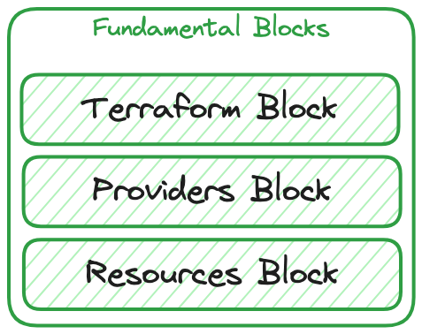
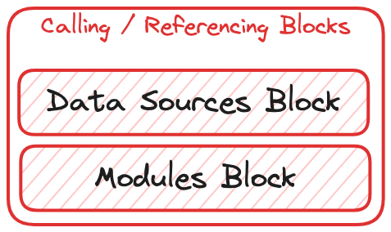
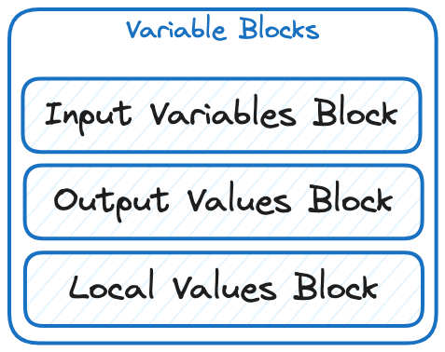
How to write OpenTF files

Slide 8
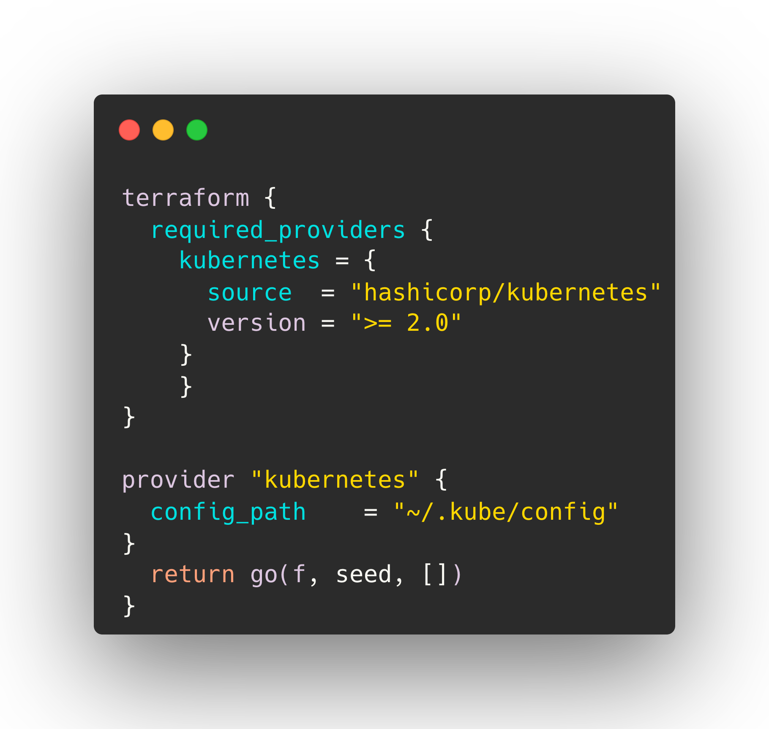


How to write OpenTF files

Slide 9
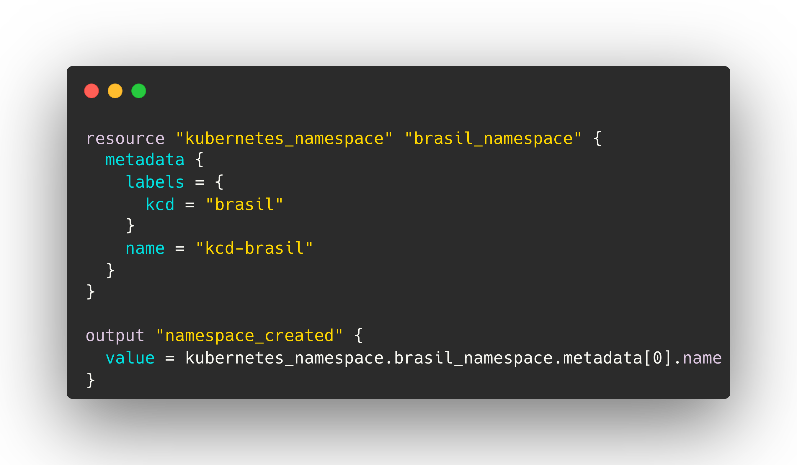


How to write OpenTF files

Slide 10



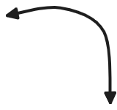

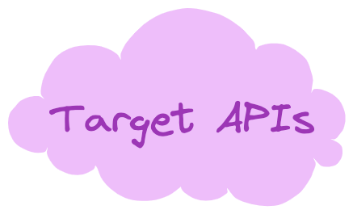
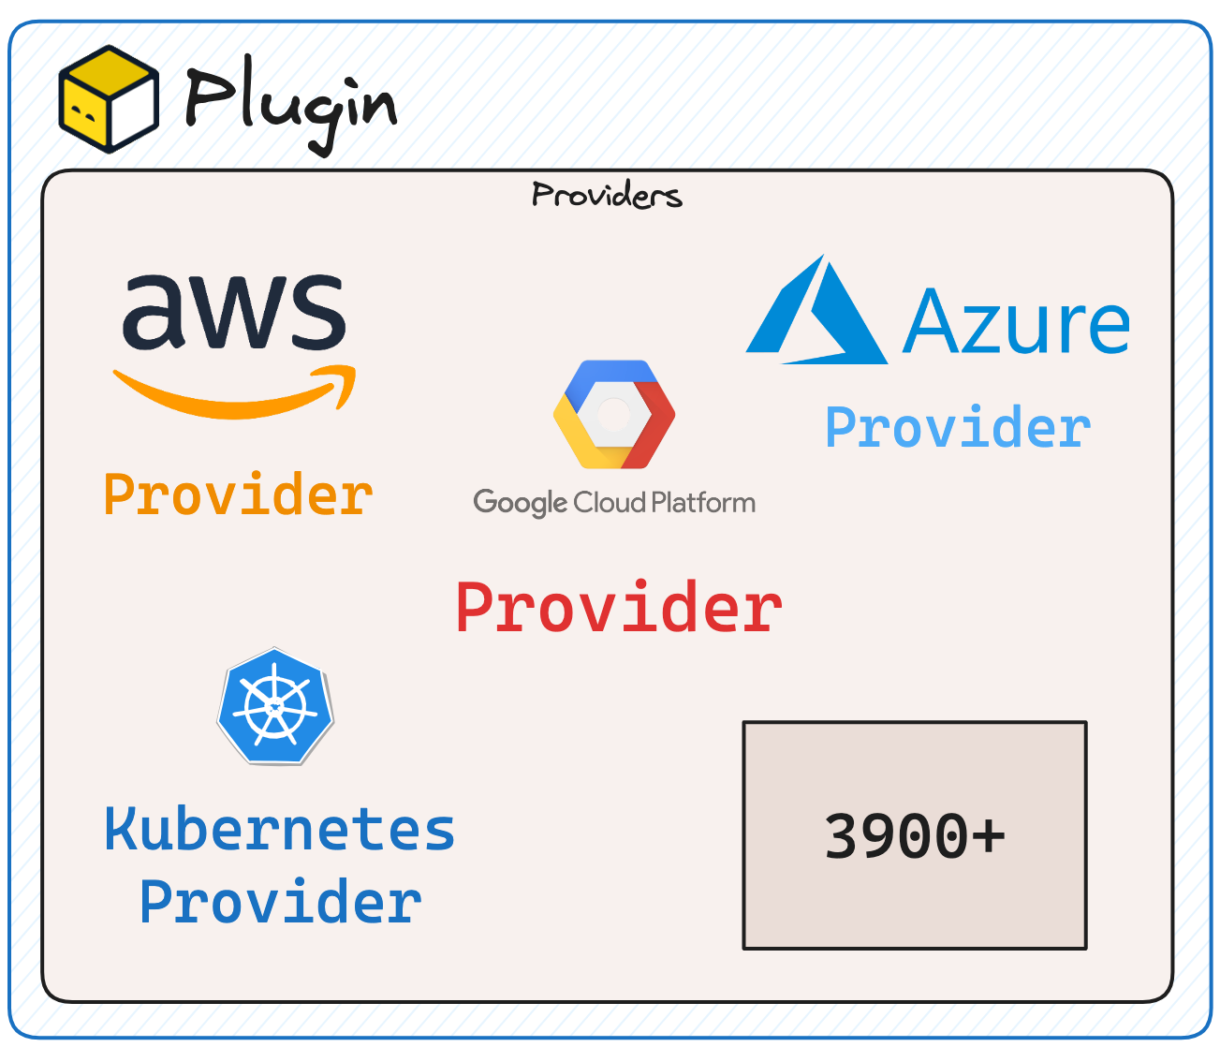
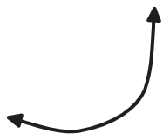

OpenTF Core and Plugins
OpenTofu is split into
two main parts

Slide 11
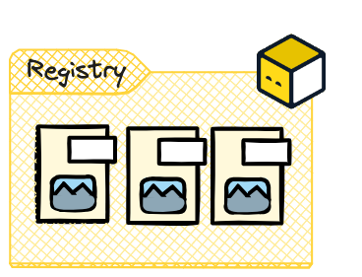



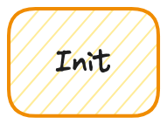






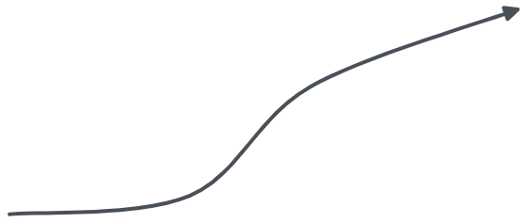





Write OpenTofu
Configuration code

Slide 12
Demo
tofu provider
tofu init
tofu plan –out name.out
tofu apply name.out
Notes:
Intro Demo
cd /home/nicola/opentofu-kubeadm/kcd-demo/
cp kcd-init/main.tf .
tofu providers
tofu init
tree .terraform
ls $HOME/.kube/config
tofu plan
kubectl get ns kcd-brasil
cp .kcd-kubernetes/namespace.tf .
cat namespace.tf
tofu plan -out kcdplan
tofu apply kcdplan
kubectl get ns kcd-brasil

Slide 13
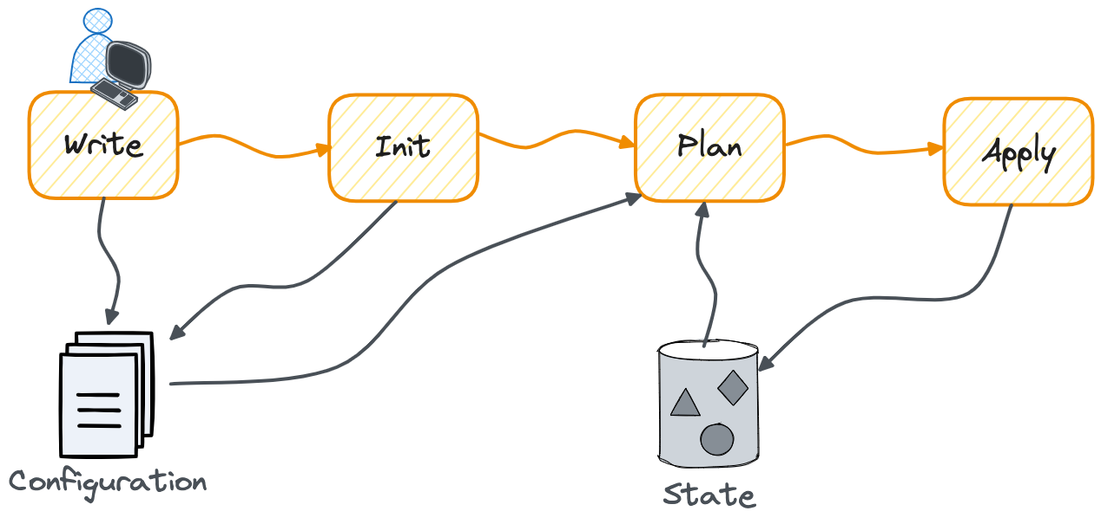
OpenTF State File

Slide 14


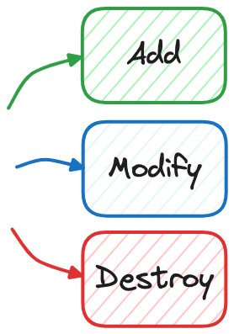

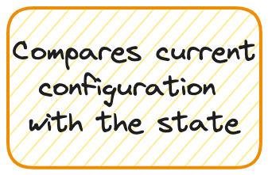
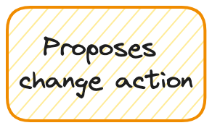



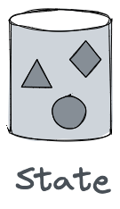
OpenTF State File

Slide 15
Demo
tofu state list
tofu destroy
Migrate state to Kubernetes
Notes:
cat terraform.tfstate
tofu state list
cp .kcd-state/whoami.tf .
vim whoami.tf
tofu apply
curl 10.10.39.128
kubectl get all -n kcd-brasil
tofu state list
tofu destroy
kubectl get ns kcd-brasil
cp .kcd-state/main.tf .
rm terraform.tfstate*
tofu init
tofu apply
kubectl get secret tfstate-default-tfstate -o jsonpath="{.data.tfstate}" | base64 -d | gzip -d -
tofu destroy

Slide 16
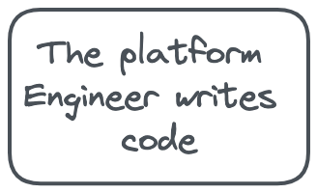








OpenTF Workflow

Slide 17





Deploy Helm Chart with OpenTF

Slide 18
Demo
tofu apply (Helm chart)
Notes:
cd .kcd-helm
vi main.tf
tofu init
vi helm.tf
tofu apply
helm list -n hello-world
tofu destroy

Slide 19
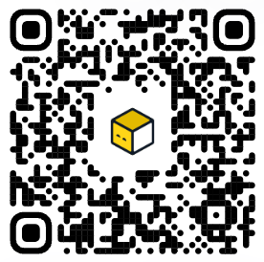
Muito obrigado!
Tiene Preguntas?
Find me on Github!

